Slide 1




Slide 2

STRESS INTERVIEW

Slide 3
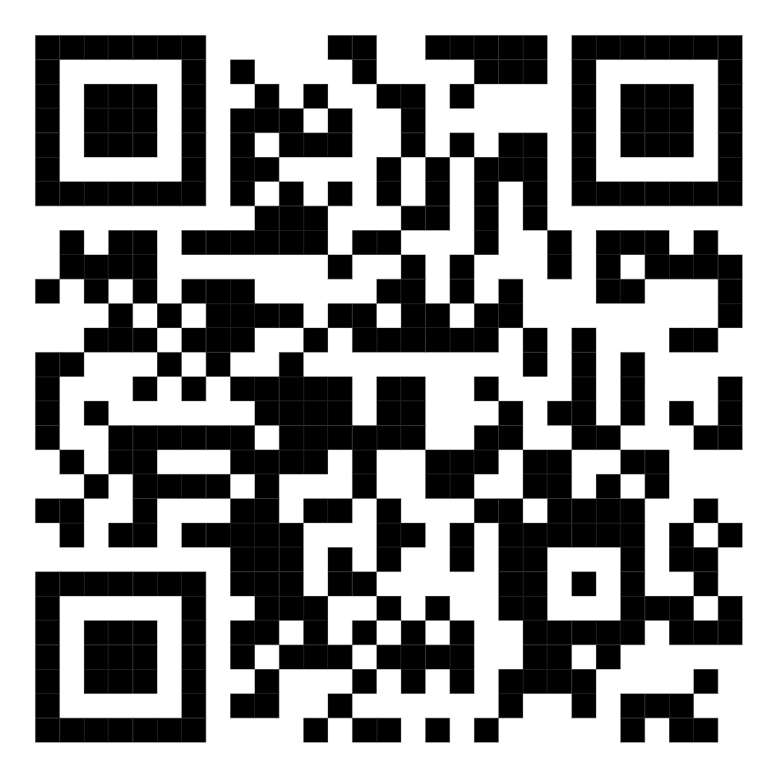
TEST TIME ON PANEL INTERVIEW
QR CODE:

Slide 4

CONCEPTS
What Is A Stress Interview?
Notes:
A stress interview takes place when an interviewer asks intimidating or mildly uncomfortable questions in hopes of witnessing how a potential employee performs in a stressful situation. This type of interview gives the hiring team an opportunity to gauge how a candidate responds to stress, prioritises multiple important tasks, or deals with challenging clients. The tactics used in these interviews vary based on the type of role the hiring team needs to fill. Hiring teams may ask complex or confusing questions, conduct a simulation or role-play to see how you act in a certain situation or ask you to perform a task to witness your technical abilities.
For example, if you applied for a role in consulting, the interviewer might ask you a question that sounds like a riddle. These questions have more than one answer, but they test your problem-solving and critical thinking skills. The interviewers typically take note of your tone of voice or the amount of time you take to give an answer.

Slide 5

CONCEPTS
How Do You Prepare For A Stress Interview?
Notes:
If you applied for a high-stakes position or a job in a fast-paced environment, you might experience a stress interview during the hiring process. Follow these steps to prepare for this type of interview:

Slide 6

CONCEPTS
1. Research the company
Notes:
As with any job, it is helpful to research the company you apply to before interviewing. This prepares you with some knowledge about the company's mission and goals while giving you an understanding of the type of employee they look for. If they emphasise a fast-paced workplace or mention their employee's ability to work under pressure, you might expect an interview that assesses how you perform in this type of setting.

Slide 7
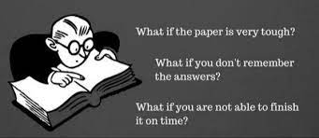
CONCEPTS
2. Remember to think through your answers
Notes:
When asked a stressful question, take time to think through your answers before responding. You can pause before answering to give yourself a bit of time to develop an answer. This helps your responses sound professional, thoughtful, and polished. However, try to answer quickly enough so the hiring manager knows that you can respond efficiently in this type of situation.

Slide 8

CONCEPTS
3. Practise
Notes:
One of the best ways to prepare for an interview with stressful questions is to practise your answers. You can ask a friend to act as the interviewer while you rehearse possible responses. Practising variations of potential questions may calm you down during the actual interview session. Instead of memorising an answer, try practising your responses a few different ways. This helps your interview feel natural and conversational.

Slide 9

CONCEPTS
4. Seek feedback
Notes:
Another way to prepare for the interview is to seek feedback from a trusted source. You might ask a colleague or a former supervisor to provide advice on how to best answer stressful questions. Feedback equips you to work on areas of improvement and focus on your strongest qualities as you get closer to the interview. Additionally, you might ask the interviewer or hiring team how you did after the interview.

Slide 10

CONCEPTS
Candidates have the opportunity to understand the work and how to interact with future colleagues
Notes:
Because the interviewer wants to see how you perform in a challenging situation, they may ask uncommon or strange interview questions. They are designed to elicit a response to show the interviewer your skills under pressure.

Slide 11
CONCEPTS
Some typical stressful questions an interview may ask include:
Why were you let go from your last position?
What other companies are you interviewing with?
What would you do if you saw a colleague stealing supplies?
How would you handle undeserved criticism from a supervisor?
What did you do when you disagreed with a supervisor?
How many other jobs are you applying for?
What would you do if a client insulted you in front of your colleagues?
How do you think this interview is going so far?

Slide 12

CONCEPTS
What Industries Use Stress Interviews?
Notes:
It is common for industries to conduct this type of interview when the work itself contains stressful elements. Several high-stakes positions require some degree of training, and it is crucial for employees to make use of their training, even in a challenging situation. If you have the correct training for a job, that training's likely to help you perform well. This interview-style attempts to understand if an applicant's training is thorough and withstands stress. Some industries that may benefit from this interview-style include:

Slide 13

CONCEPTS
Medical professions
Notes:
People interviewing for a job in the medical field may experience a stress interview because these high-stakes jobs help solve and manage health problems. Because many medical positions require extensive training, education, or experience, it is likely that this interview style helps hiring teams understand how each applicant may perform in a hectic medical setting. For example, someone applying to be a nurse in the intensive care unit may have an interview ask about what to do in specific instances. The applicant's responses show the interviewer their depth of knowledge and ability to react quickly.

Slide 14

CONCEPTS
Management and consulting professions
Notes:
In business settings where management and consulting professionals are responsible for company assets, a hiring team may implement this interview style. It is important for people in these industries to make strategic and critical decisions with confidence to ensure that the companies and clients they manage trust their work and succeed because of it. For example, an applicant for a consulting firm may experience a role-play interview where the hiring team acts as a client. The applicant carries out a fabricated conversation with the client so the hiring team sees how they might act in different business scenarios.

Slide 15

CONCEPTS
Financial services
Notes:
Investors, stockbrokers, or financial managers have stressful jobs that develop rapidly as money is spent or acquired. The people who trust these professionals with their funds want to ensure that their money's safe and protected. An interviewer in this field may ask an applicant to complete complex math problems to assess their ability to execute tasks under pressure.

Slide 16

CONCEPTS
Law enforcement
Notes:
The Rapid Action Force (RAF) and other types of law enforcement professionals have jobs that require focus, knowledge, and quick thinking. These professionals respond to critical situations and help diffuse tension or prevent crime. Stressful interviews for these roles may include certain skills tests, such as horseback riding or handling equipment. Testing these skills helps hiring teams understand the abilities of the applicants to perform tasks under pressure.

Slide 17

CONCEPTS
Airline professions
Notes:
Pilots, plane mechanics, or flight attendants all work on aeroplanes to oversee the safety and success of flights. It is crucial that each person working on the plane knows how to manage challenging situations such as turbulence or technical difficulty. For example, aspiring pilots undergo extensive training, including flight hours, supervised flights, and other performance-based interviews that measure their ability to fly in a stressful environment.

Slide 18

CONCEPTS
Technology professions
Notes:
IT managers, software developers, and data security managers work to prevent and solve issues with technology and databases. Often, these professionals think critically to develop a quick solution to a technological problem. Some databases may include sensitive data that requires a high level of protection. Interviewers for a technology profession may ask complex technical questions or riddles to assess an applicant's ability to problem-solve and pay attention to details.

Slide 19

CONCEPTS
Are Stress Interviews Effective?s
Notes:
The effectiveness of this interview type depends on the workplace and the position you applied to. However, there are benefits and disadvantages, including:

Slide 20

CONCEPTS
Benefits
Notes:
These interviews help the hiring team assess how someone performs in a stressful situation, which demonstrates how the candidate might perform in the role. This can provide useful insight when making a decision about who to hire. Additionally, candidates have the opportunity to demonstrate their skills in a unique way. Answering stressful questions with poise and confidence shows interviewers their abilities.

Slide 21

CONCEPTS
Disadvantages
Notes:
These interviews might provide less information to the interviewer about the candidate if the majority of questions focus on stress rather than the candidate's skills and experience. However, interviewers may incorporate both types of questions into the interview to understand the applicant more holistically.

Slide 22

https://learn.codemithra.com

Slide 23




THANK YOU
+91 78150 95095
codemithra@ethnus.com
www.codemithra.com

